Slide 1
Presentation brief for MCT’s
Title of presentation | Ingest and load data into the data warehouse
Presentation\Lab length | Presentation: 15 - 20 minutes Lab: 50 – 60 minutes
Audience | Data Engineers, Data Scientists, Data Professionals, Data Architects, BI Professionals, Developers
Purpose | Understand the different ways that you can ingest and load data into a data warehouse Understand the best practices associated with ingesting and loading data Use the Copy Activity in Azure Data Factory/Azure Synapse Pipelines
(think) Student key takeaways | The student should know the difference between PolyBase, Copy and the Copy activity The student should be able to list 5 data loading best practices The student should understand how the Copy Activity can simplify the process of data ingestion
(feel) Student desired mindset | The student may feel that this is a complex area and not be familiar with all of the available options The student may feel that they need clarification of some of the data loading best practices you present
(do) Student outcomes | The student should be able to use the PolyBase and Copy statement The student should be able to implement at least three data loading best practices The students should be able to use the Copy Activity
More information | For MCT course feedback, visit the Microsoft Official Courseware forum
Notes:
Instructor notes.
This slide is for MCT use only, outlining the aims and objectives of this module.

Slide 2
DP-203T00: Ingest and load data into the data warehouse
Notes:
Instructor notes and guidance.
Data Ingestion is an extremely important part of data engineering that involves balancing the needs of source systems, ensuring that you do not disrupt them from their purpose, with the needs of loading the data into a data store that is part of an analytical system. Not only does this module show the students how they can ingest the data with a variety of techniques including PolyBase and the Copy command, but you will also find that you will be spending time sharing with the students the considerations that they must consider when ingesting and loading data. To that end, you will teach the students the common best practices that we have observed with customers. It is quite possible that slide 4 is one of the longest slides that you will teach given the breadth of content, but the notes will prepare you well to answer any questions that you will face in this area.
With that understood, the second part of the module explore a simple way you can ingest data without writing code. Here you will explore the Copy Activity that is available in both Azure Data Factory and Azure Synapse Pipelines. The students will make use of this in exercise two of the lab, so it will be better to allow them to get their hands on it rather then spending too much time teaching it.

Slide 3

Agenda
Lesson 01: Use data loading best practices in Azure Synapse Analytics
Lesson 02: Petabyte-scale ingestion with Azure Data Factory
Notes:
Instructor notes and guidance.
This space has been left deliberately blank

Slide 4
Use data loading best practices in Azure Synapse Analytics
Manage source data files
Manage singleton updates
Set-up dedicated data loading accounts
Manage concurrent access to Azure Synapse Analytics
Implement Workload Management
Use PolyBase, the Copy command or the Copy Activity in Azure Data Factory
Notes:
Talking points
The first two best practices are straight forward. Splitting a large file into smaller files takes advantage of the parallelism provided by the Massively Parallel Processing (MPP) architecture within Azure Synapse Analytics dedicated SQL pools. Managing singleton updates to develop one process that writes the outputs of an INSERT statement to a file, and then another process to periodically load this file also takes advantage of the parallelism that Azure Synapse Analytics has.
The second two points manages the concurrent access to the system to optimize the data loads. Setting up a dedicated data loading account, assigned to different resource classes dependent on the anticipated task will optimize load performance and maintain concurrency as required by managing the available resource slots available within the dedicated SQL Pool. Also reducing or minimizing the number of simultaneous load jobs at the same time manages the concurrent access to Azure Synapse Analytics
If bullet point three and four are difficult to implement, then bullet point 5 could help. If you are unable to minimize the amount of concurrent load jobs, or allocate fixed resources to a workload group. You can assign maximum and minimum usage for varying resources under load. These adjustments can be done live without having to take Azure Synapse Analytics offline, and provides the following benefits:
Reserve resources for a group of requests
Limit the amount of resources a group of requests can consume
Shared resources accessed based on importance level
Setting the Query timeout value reduces the need for DBAs to runaway queries
Exercise 1 of the lab focuses on the final bullet, specifically using PolyBase, and the Copy command, and you can share your own example or example of these from the lab
Instructor notes and guidance.
You will spend about 15 minutes discussing some of the best practices on this slide. It is an important aspect of creating a scalable data warehousing solution. What is covered here are the more common best practise that we have observed with customers, there are others that you can add yourself from the following URL Data loading best practices - Azure Synapse Analytics | Microsoft Docs
Recommended reading for this slide
Use data loading best practices in Azure Synapse Analytics - Learn | Microsoft Docs

Slide 5
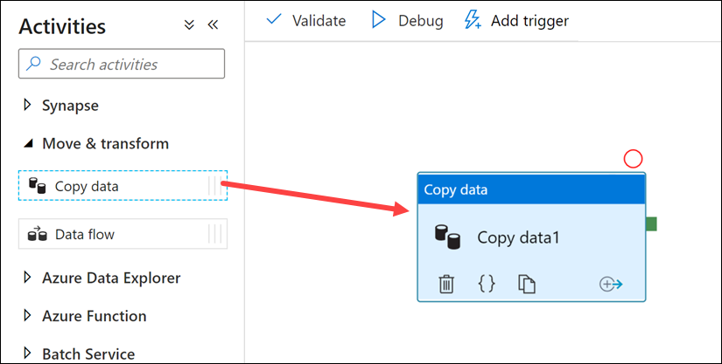
Petabyte-scale ingestion with Azure Data Factory
Notes:
Talking points
Use this method to build code-free data ingestion pipelines that don’t require any transformation during the extraction of the data. The Copy Activity has support for over 100 native connectors. This method can suit new start-up projects that have a simple method of extraction to an intermediary data store. An example of ingesting data using the Copy Activity can include extracting data from multiple source database systems and outputting the data to files in a data lake store.
The Copy activity performs the following steps:
Reads data from a source data store.
Performs serialization/deserialization, compression/decompression, column mapping, and so on. It performs these operations based on the configuration of the input dataset, output dataset, and Copy activity.
Writes data to the sink/destination data store
Instructor notes and guidance.
You may want to consider running a simple demo of the copy activity yourself to show how to setup the copy activity in Azure Data Factory/Azure Synapse pipelines. Inform the students that they will get to explore the Copy Activity in exercise 2 of the lab.
Recommended reading for this slide
Use data loading best practices in Azure Synapse Analytics - Learn | Microsoft Docs

Slide 6
Review questions
Q01 – Which data loading feature limits the number of resources a group of requests can consume in Azure Synapse Analytics?
A01 – Workload management
Q02 – Why should you split up one large files into smaller files when loading data into a dedicated SQL pool in Azure Synapse Analytics?
A02 – To take advantage of the Massively Parallel Processing (MPP) architecture
Q03 – In which section of the Data Factory designer canvass would you find the Copy Activity?
A03 – Move and Transform
Notes:
Instructor notes and guidance.
This space has been left deliberately blank

Slide 7
Lab: Ingest and load data into the data warehouse
Notes:
Instructor notes and guidance.
This space has been left deliberately blank

Slide 8
Lab overview
This lab teaches students how to ingest data into the data warehouse through T-SQL scripts and Synapse Analytics integration pipelines. The student will learn how to load data into Synapse dedicated SQL pools with PolyBase and COPY using T-SQL. The student will also learn how to use workload management along with a Copy activity in a Azure Synapse pipeline for petabyte-scale data ingestion.
Lab objectives
After completing this lab, you will be able to:
Use data loading best practices in Azure Synapse Analytics
Petabyte-scale ingestion with Azure Data Factory
Notes:
Instructor notes and guidance.
In exercise one, you will explore loading data by using Transact-SQL statements, and deliberately compare PolyBase and the Copy command so that the student get to see for themselves which method they would like to use. Code is provided in the lab, but you may want to take students who are less familiar with T-SQL through the code, so they understand how it work. Exercise 2 begins by exploring the data loading best practice of working with workload management so that you can manage the priority of a data load. They then move onto the Copy Activity to simplify data ingestion, and deep dive into the settings that are required to set this up successfully.

Slide 9


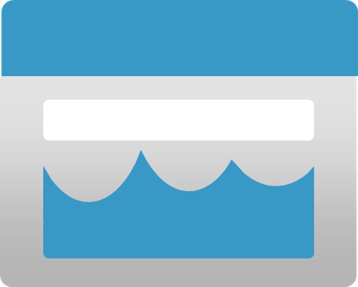








Lab 07 Overview
asacosmosdb<unique_suffix>
CosmosDB
Campaign Info
Azure Databricks
asagadatalake<unique_suffix>
Cluster
Azure Data Lake
wwi-02
Sales (parquet)
Customer (csv)
dp203sql<unique_suffix>
SourceDB
Synapse Analytics
Dedicated SQL Pool (SQLPool1)
Built-In Serverless SQL Pool
Apache Spark pool
Pipelines and Dataflows
Power BI
asagaworkspace<unique_suffix>
Notes:
This slide is an optional slide that you can use to show a high-level overview of the technologies used in the lab.
This lab teaches students how to ingest data into the data warehouse through T-SQL scripts and Synapse Analytics integration pipelines. The student will learn how to load data into Synapse dedicated SQL pools with PolyBase and COPY using T-SQL. The student will also learn how to use workload management along with a Copy activity in a Azure Synapse pipeline for petabyte-scale data ingestion.

Slide 10
Lab review
Question 1 – What is the appropriate distribution to use in a staging table?
Question 2 – When creating an External Data Source, what should the Type property be set to access data in a data lake?
Question 3 – When setting file format properties for a data source in the Copy Activity, you can import the schema from a connection/store and what other option?
Question 4 – You want to truncate a staging table before loading it with data in a Copy activity. Which sink property would you set to do this?
Notes:
Answers
Question 1 - DISTRIBUTION = ROUND_ROBIN is the best distribution to use for staging tables as it is the most efficient distribution for loading data
Question 2 – TYPE = HADOOP is the property that should be set in the External Data Source to access data in a data lake
Question 3 – The other option is sample file. This is a useful option to use when the source connection is very big. On big tables, to import the schema from it will take time, by having a sample file which only contains a smaller data set will resolve the schema much quicker.
Question 4 – The sink property to truncate a staging table before loading it with data in a Copy activity is the Pre-copy script property

Slide 11
Module summary
In this module, you have learned about:
Use data loading best practices in Azure Synapse Analytics
Petabyte-scale ingestion with Azure Data Factory
Next steps
After the course, consider reading [Best practices for loading data using dedicated SQL pools in Azure Synapse Analytics] for more guidance on data ingestion and loading
Notes:
Instructor notes and guidance.
The next steps is suggested post course learning materials to reinforce what they have learned in the module.

Slide 12
Closing slide
Notes:
Instructor notes and guidance.
This space has been left deliberately blank

